Slide 1
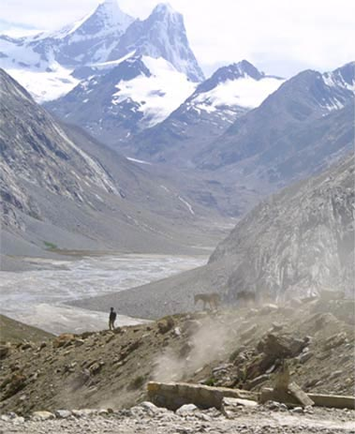
Fellowship of the Heart
Getting Started — the Four Connects, walked around the table on alternating evenings
Evening Series 2026–27 · at the Tittle home · v1.5E DRAFT
All Scripture: ESV · The Companion lesson plans carry the full scripts — these slides carry the room
1
Notes:
DECK TITLE · pre-session · DIVIDER
On screen as the room assembles on night one. All Scripture ESV; the plans carry the scripts; these slides carry the room — and these notes carry you.

Slide 2
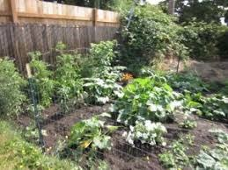
SESSION 10
The Garden of Your Heart II
The second guided run — the room returns to the garden deeper for a week of practice; a Companion-in-Formation leads the walk-through, and the adults hold the debrief
Quarter 2: Connect with God
126
Notes:
S10 · pre-session · DIVIDER
On screen through dinner and as the circle forms. Greet at the door — the slide holds the room.

Slide 3
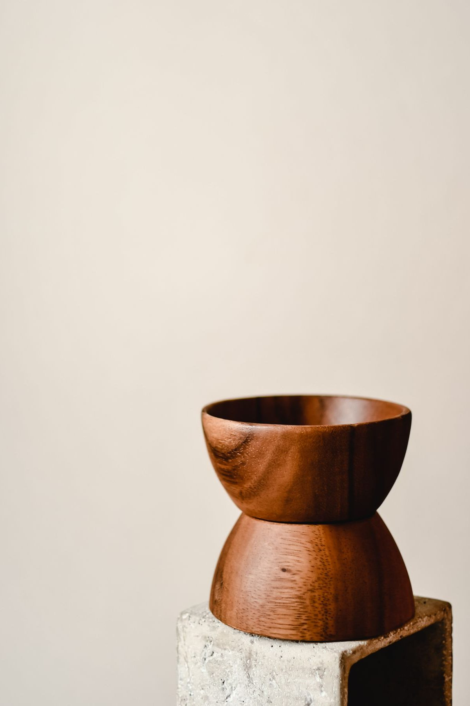
Session 10 — Tonight’s Road
1 Welcome and centering
2 Garden week check-in
3 Scripture and brief re-framing
4 Bridge to the exercise
5 The Garden exercise — whole room, then pairs
6 Merge and one-word landing
7 Homework commissioning — handout + check-in partners
8 Leader Feedback Round
9 Closing container
127
Notes:
S10 · 7:00–7:08 · LEAD: CONTAINER HOLDER
BEATS: 1. Second garden run: nothing new is taught — today completes what Week 9 began, and a senior reads the walk-through for the whole room. 2. The bright line on display: the teen leads the scripted walk-through; the adults hold the sharing and anything that surfaces. 3. The first visit finds the garden; the second visit begins the tending.
CUES: Pre-session check-ins with anyone whose Week 9 garden was dark or empty — going back in is optional; sitting and praying instead is fully honored, no explanation owed.

Slide 4
Opening Container — the Eight Steps
1 Welcome — five minutes to open the container
2 Phones silenced and put away
3 Stand in a circle
4 One-word check-in — how you actually are, right now
5 Put out / bring in — set something down; bring a blessing in
6 Spoken commitment: “I am here. I am paying attention. I am willing to be moved.”
7 Opening prayer — “Holy Spirit, you are welcome here. Speak. We are listening.”
8 Sit. Begin.
128
Notes:
S10 · 7:00–7:08 · LEAD: CONTAINER HOLDER
BEATS: 1. Open even quieter than Week 9 — lights low if the room allows. Aaronic blessing. 2. Frame the second run: not a rerun — deeper. 3. Name the senior once, warmly, and move on: 'the words are the same words; they will read from the card, slowly, the same way I did.' No build-up — a spotlight distorts what the slot is meant to form. 4. Container unchanged: pair talk stays in the pair; nothing required — not even the exercise.

Slide 5

Garden Week Check-In
• “One sentence about a garden visit this week? Not what happened in it — just how the going was.”
– “I went twice and it was quieter than Wednesday.” “I meant to and didn’t.” “I went once and it was hard.”
• A parent offers the first sentence — never a cold call on a teen; each one received identically
• “There is no junior varsity garden. Jesus meets each person in the garden they actually have.”
129
Notes:
S10 · 7:08–7:25 · LEAD: CONTAINER HOLDER
BEATS: 1. One sentence on how the going was this week — not what happened in the garden. 'I meant to and didn't' counts. 2. Receive each identically. 3. Land the line if comparison language surfaced: there is no junior varsity garden — Jesus meets each person in the garden they actually have, and the backyard He walks into is holy ground.
CUES: Arranged parent offers the first sentence (check the Run Card) — never cold-call a teen; pass-anytime holds.

Slide 6
Scripture and Brief Re-Framing
• Same two anchors as last week — Psalm 23 and John 15:1–11 — “Listen as if for the first time anyway.”
• A vinedresser does not visit a vine once — abiding is a rhythm, not an event
• Going back changes things — the garden is not a photograph; it is a living place, because your heart is
• A hard garden last week? Going back in tonight is optional — sit and pray instead, fully honored, no explanation owed
• “The words get you to the gate; the silence is where He meets you.”
PSALM 23:1–3
“The Lord is my shepherd; I shall not want. He makes me lie down in green pastures. He leads me beside still waters. He restores my soul.”
130
Notes:
S10 · 7:25–7:34 · LEAD: CONTENT PRESENTER
BEATS: 1. Re-read Psalm 23 and John 15:1–11, slowly — same anchors on purpose; the room hears them differently now. 2. Keep the framing SHORT — the theology was laid last week. 3. The second-visit frame: the garden is a living place; going back changes things. 4. The open door, said clearly: anyone whose garden was hard may sit with eyes open and simply pray while the others walk — a faithful way to spend the half hour; nobody will ask why. 5. Today the guide talks less and the silences run longer — on purpose. You know the way now.

Slide 7
Bridge to the Exercise
• Same shape as last week — guided walk-through, about twelve to fifteen minutes, all of us together in this room
• Read slowly, with longer quiet than last time — then five minutes with your journal
• Then pairs for sharing by invitation only — “Silence is a complete answer.”
• “Father, You are the vinedresser. We are going back into the gardens You already know. Walk where You want to walk. Tend what You want to tend.”
131
Notes:
S10 · 7:34–7:36 · LEAD: CONTENT PRESENTER · TRANSITION
BEATS: 1. Same shape as last week: walk-through 12–15 min, all together in this room, longer quiet than last time; then journaling; then pairs for sharing by invitation — silence is a complete answer. 2. Pray: 'Tend what You want to tend.' 3. No move yet — the room stays as one circle for the walk-through; the pairs come after the journaling.

Slide 8

The Garden Exercise — Whole Room, then pairs
1 Settle (2 min) — then, simply: “[Name] will read for us tonight.”
2 Guided walk-through, senior-led (12–15 min) — same protocol as Week 9, longer pauses; the card carries the room
3 The visible handoff — “[Name], the room is yours.” / “Thank you, [name]. That was well led.”
4 Silent journaling (5 min) — what was the same as last week, what was different
5 Sharing in pairs (10–12 min) — by invitation only; a parent opens; silence is a complete answer
• The bright line — the teen leads the walk-through; the adults hold the sharing and anything that surfaces
132
Notes:
S10 · 7:36–8:13 · LEAD: CONTENT PRESENTER
BEATS: 1. Settle 2 min, then the senior reads the walk-through from H10.1 — two words per second; (pause) = 30 full seconds, (longer pause) = 60, longer than Week 9 on purpose. Reading from the card IS the design. 2. Mid-read distress: the senior keeps reading, same pace, same volume; the pre-named adult moves to the person. Neither covers for the other. 3. The visible handoff when it ends: senior — '[Name], the room is yours.' Adult — 'Thank you. That was well led.' From there the adults carry everything. 4. Journaling 5 min, then pairs: arranged parent opens; receive without interpreting.
GUARD: Settle Protocol if overwhelm exceeds the two-role hold — stop for them, not the circle; no return to the exercise today. The senior never takes a disclosure, even a fragment — hand it to the adult immediately.

Slide 9
Merge and One-Word Landing
• “What happened in your pair stays in your pair.”
• One word each, when you’re ready — not what was said, but what you noticed; you can pass
– “Deeper.” “Same.” “Tender.” “Quiet.” “Harder.” “Found.”
• A parent offers the first word — each one received without commentary
• “A garden visited twice is a garden being tended. Whatever He is doing in yours, He will keep doing it this week.”
133
Notes:
S10 · 8:13–8:20 · LEAD: CONTENT PRESENTER
BEATS: 1. Quieter than last week — honor it; wait. 2. One word each, optional: 'deeper', 'same', 'tender', 'harder', 'found'. Receive with eye contact and a slight nod; say nothing else. 3. Close: a garden visited twice is a garden being tended — whatever He is doing in yours, He will keep doing this week.
CUES: Arranged parent offers the first word; pass-anytime holds.

Slide 10
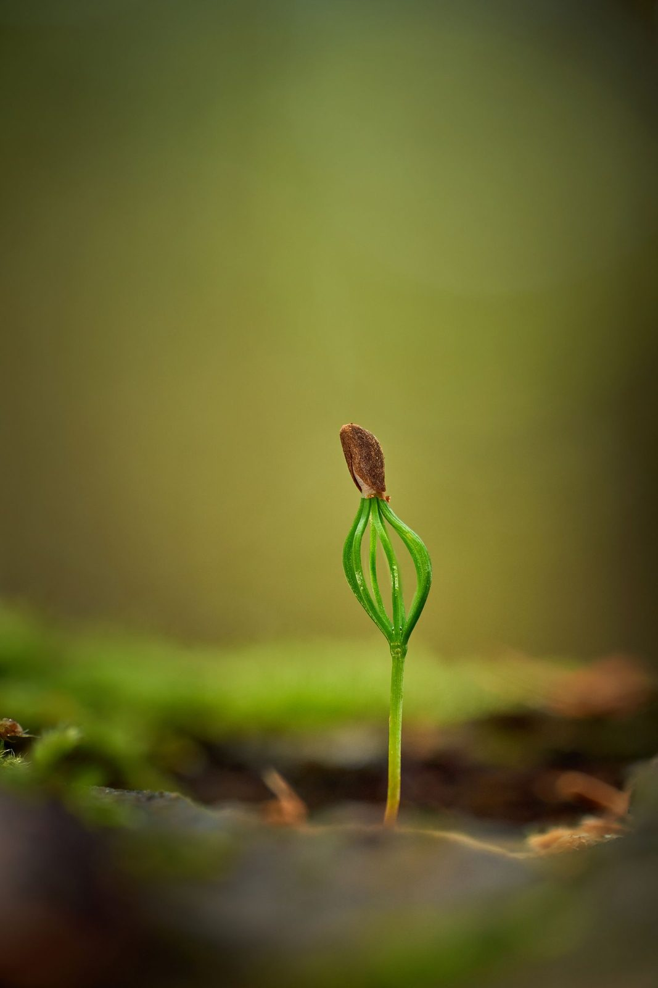
Homework — Two Weeks, Four Parts
• Keep the garden rhythm — two returns this week, five to ten minutes each
• “You know the way now — you don’t need the script.” Go back, walk a little, notice where He is
• Journal each visit — even two sentences — “the garden speaks slowly, and the journal is how you hear it across weeks”
• If a return surfaces something heavy — stop, open your eyes, come back another day; tell a trusted adult
• Three visits drops to two on purpose — a rhythm that survives, not a sprint that impresses
134
Notes:
S10 · 8:20–8:24 · LEAD: CONTENT PRESENTER
BEATS: 1. Co-Companion (Parent) leads. Two garden returns this week, 5–10 min each — the load drops from three on purpose; a rhythm that survives beats a sprint that impresses. 2. Journal each visit, even two sentences — the garden speaks slowly; the journal is how you hear it across weeks. 3. Same gentle word: if a return surfaces something heavy, stop, and tell a trusted adult. Fresh Garden Journal pages at the door.

Slide 11
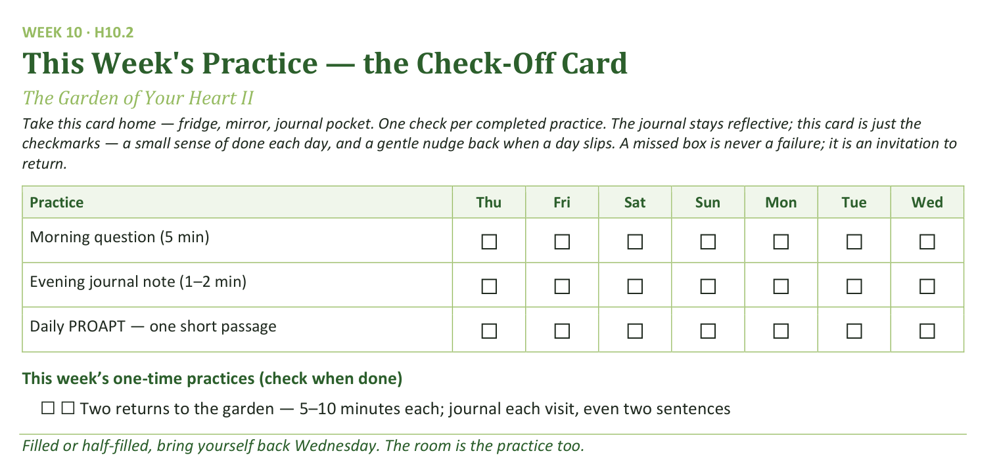
Your Take-Home Card — This Session’s Practice
Handed out now — fridge, mirror, journal pocket.
135
Notes:
S10 · 8:20–8:24 · LEAD: CONTENT PRESENTER
BEATS: 1. Card home: morning question, evening note, daily PROAPT, plus two garden-return checks. 2. A missed box is an invitation to return, never a failure. 3. Keep this brief — the room is full; do not try to empty it with more words.

Slide 12
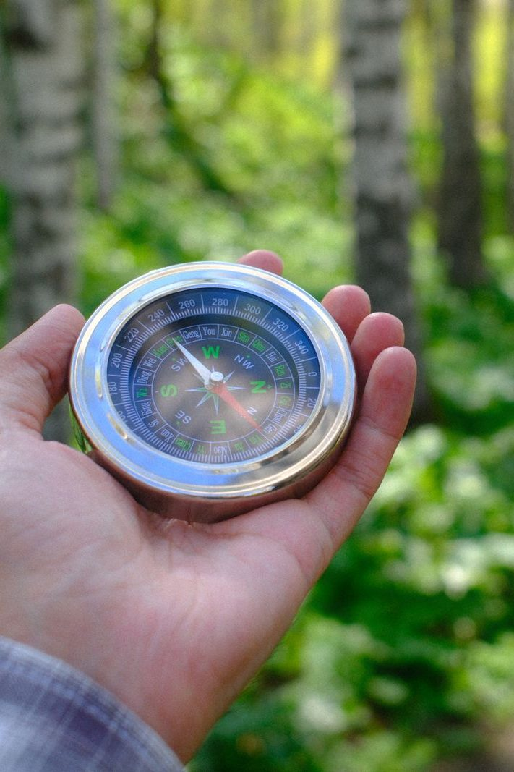
The Leader Feedback Round
• Two rounds, same as every session — the container holder first, then the content presenter: three things each
– “What I think went well tonight: ______”
– “What I’d do differently next time: ______”
– “If I were to teach tonight’s process to someone, I would tell them: ______”
• Then the room — the same two questions about tonight
• The leaders receive without defending — “thank you” is the whole response
136
Notes:
S10 · 8:24–8:28 · LEAD: BOTH LEADERS
BEATS: 1. Merged round — a teen led the deepest practice: the senior answers first, the adult second, the room by consent, covering both. 2. For a first-time guide, pace and the held silences are the honest headline; ONE thing to try differently — one, not a list. 3. If the debrief ran heavy — something still visibly in the room — DROP the round entirely; it moves to the team debrief, and the senior is told why in these words: protecting the room came first today. That sentence is the lesson, not a consolation. The blessing still closes either way.

Slide 13
Closing the Container + Aaronic Blessing
• We close the way we opened — the container, six steps:
1 Stand again — same circle, same posture as the open
2 One-word landing — compare it to your opening word
3 The one thing you are taking from tonight
4 The one practice — committed aloud, or modified to one you will actually keep
5 Blessings — specific, witnessed, short
6 Closing prayer — and the Aaronic blessing, spoken over each other, face to face
THE AARONIC BLESSING — NUMBERS 6:24–26
“The Lord bless you and keep you;
the Lord make his face to shine upon you, and be gracious to you;
the Lord lift up his countenance upon you, and give you peace.”
137
Notes:
S10 · 8:28–8:30 · LEAD: CONTAINER HOLDER
BEATS: 1. What happened in your pair is yours; carry it gently — no car-ride debrief unless the heart is fully ready. 2. If something heavy surfaced, reach out — the team is walking with you. 3. Aaronic blessing, hands up.
CUES: Stay accessible fifteen minutes after; two-adult rule for any teen. Afterward, a brief specific word of thanks to the senior, separate from the feedback round — leading deep water for the first time costs something; name that it was seen.

